Slide 1
Crack Problems
Instructor: 朱哲明 ( )
Zheming Zhu
College of Architecture and Environment, Sichuan University, China
and
Dept. of Civil Engineering, University of Toronto, Canada
Email: am.zhu@utoronto.ca; Tel:13882106617

Slide 2


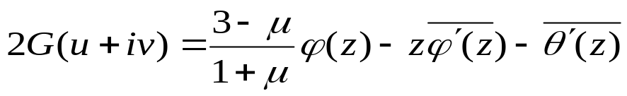
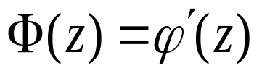
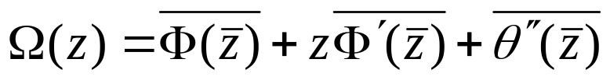
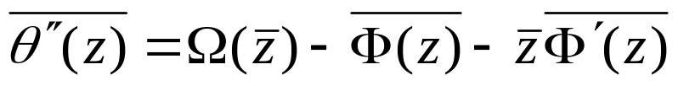
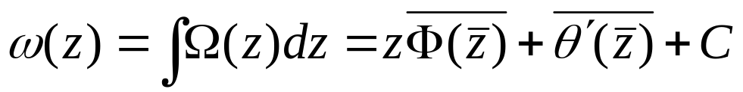
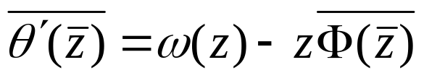
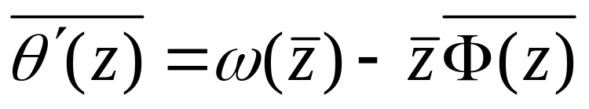
Stress
Displacement
For the issue of A plane with straight cuts, let and let
and integrating the equation, one can have
y

Slide 3
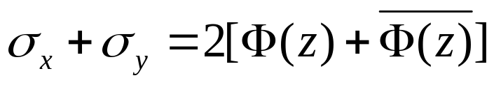
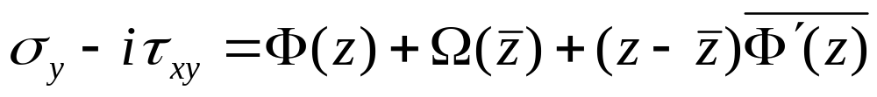
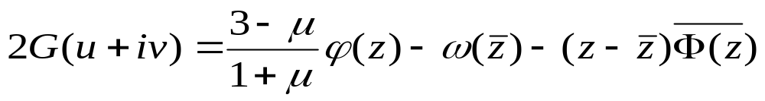
Stress
Displacement
Substituting the above results, we have
see Muskhelishvili P.516
y

Slide 4
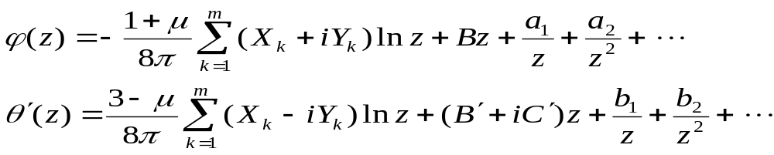
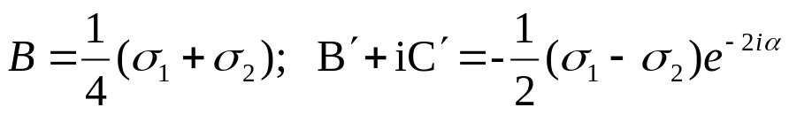
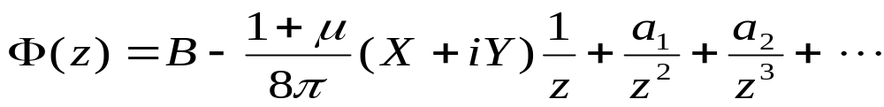
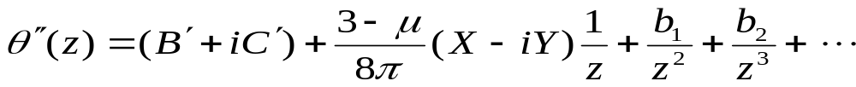
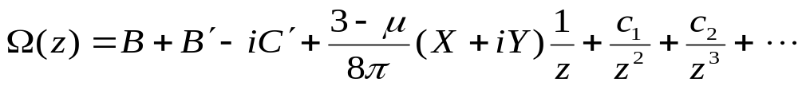
C0
Ck
According to the above results, we have
R
According to
Where X and Y are the resultant vector of external forces, applied to the cracks

Slide 5

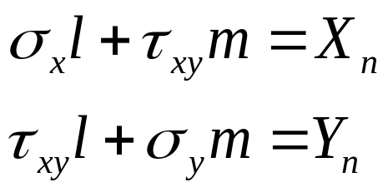







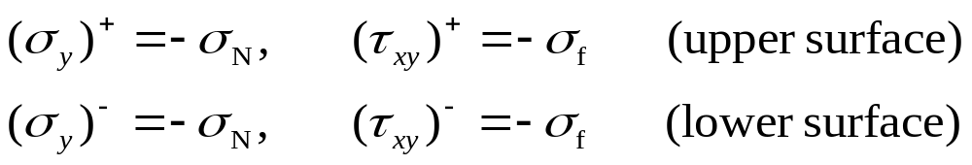
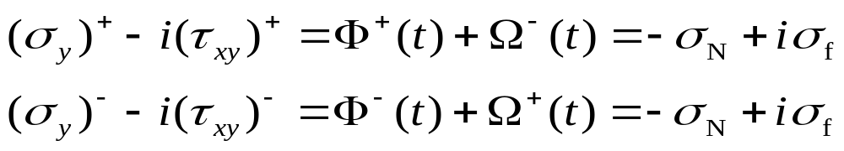
According to
A₁
B₁
A₂
where l and m are the direction cosines of the normal line of the boundary,
B₂
A₃
B₃
A_{n}
B_{n}

Slide 6
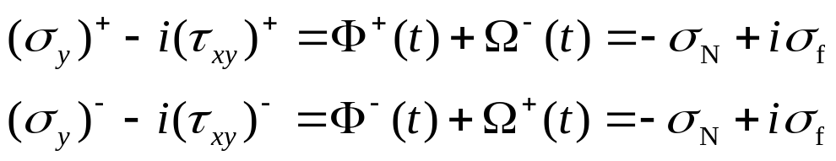
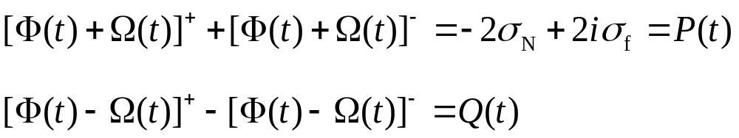
A₁
B₁
A₂
B₂
A₃
B₃
A_{n}
B_{n}
How to solve the functions ?

Slide 7

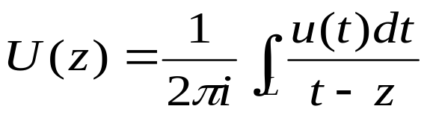
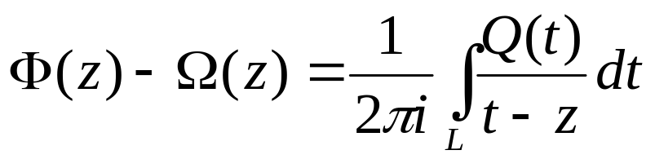
Because
Its general solution can be expressed by Cauchy integral
For the case of a finite sample, then

Slide 8
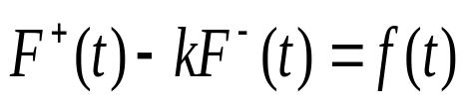
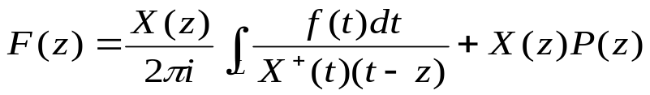
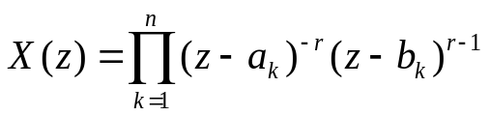
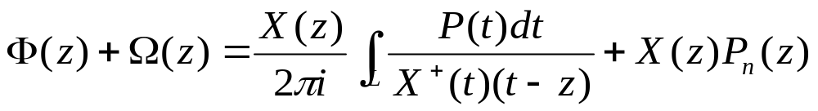
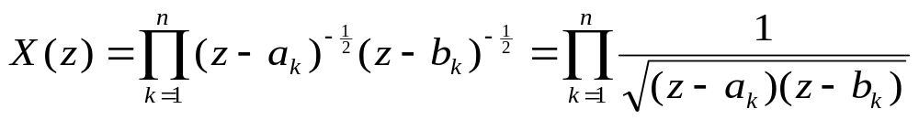
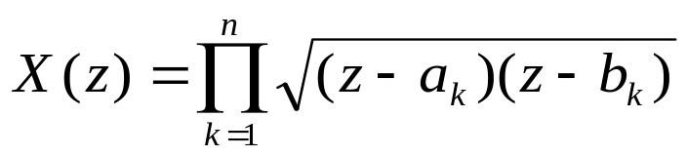
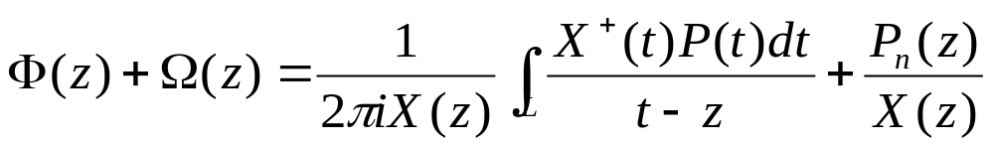
For
; K = -1
because
For simple, let
then

Slide 9
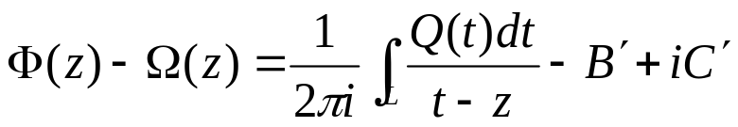
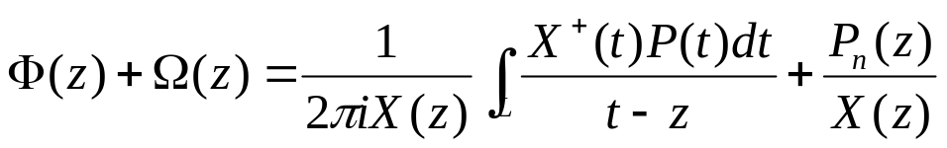
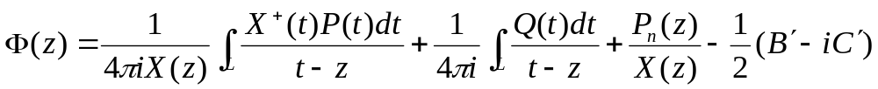
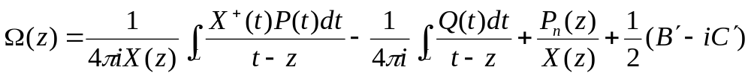
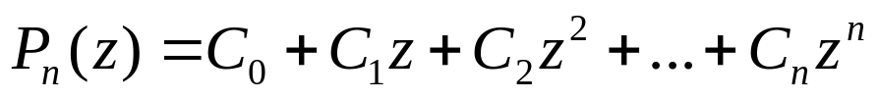
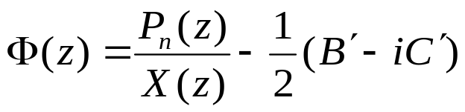
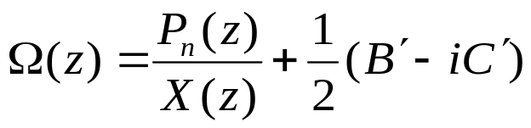
Where
n is crack number
For the case that crack surface is stress free, then

Slide 10
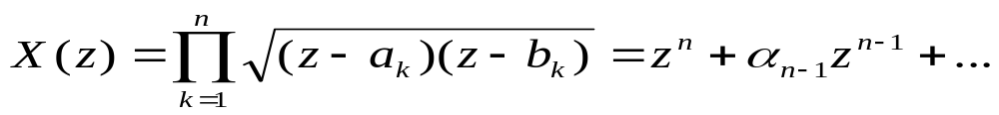
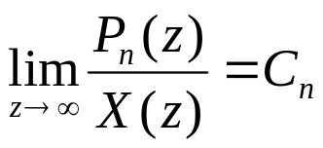
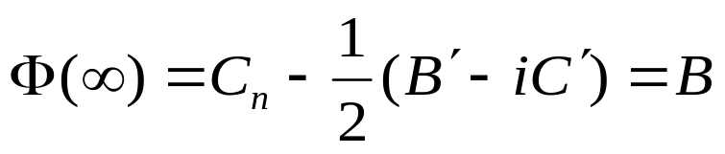
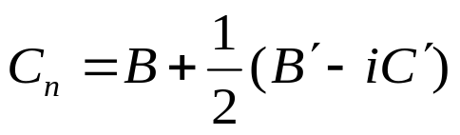
Where
n is crack number
And also

Slide 11
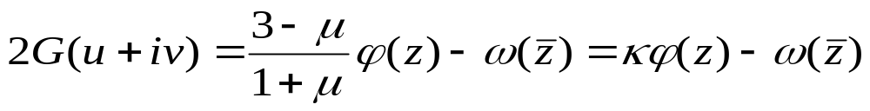
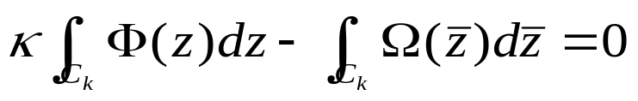


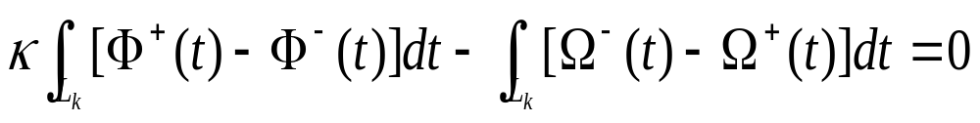


n is crack number
The remaining coefficients must be determined from the condition of single-valued displacements
At the crack surfaces,
The condition of single-valued displacements
where C_{k} is the contour of the kth crack. If the contour C_{k} shrinks to a lacet around the crack,
C

Slide 12
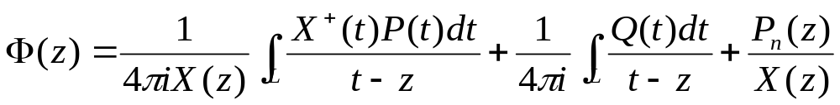
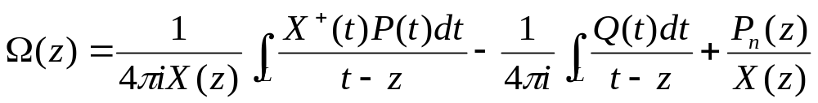
Where
n is crack number
For the case of finite sample, then

Slide 13

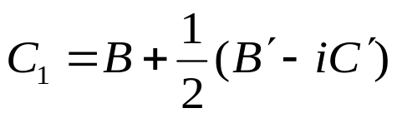
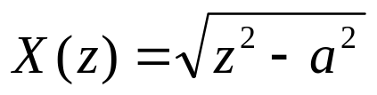
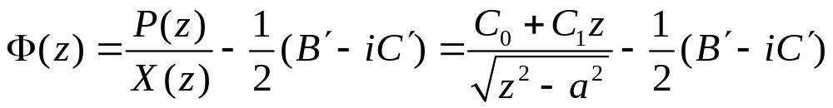
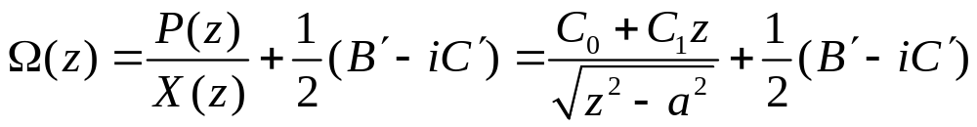
For a single crack with free surfaces
-a
a

Slide 14
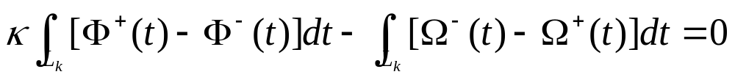

For a single crack with free surfaces
-a
a
The condition of single-valued displacements
Because

Slide 15





For a single crack with free surfaces
-a
a
where ct is the x-coordinate of crack tips

Slide 16






If the path P beginning at a point t on L, around the end a, we find will
Increases by 2π, but
returns to its original value. Thus
a
It shows that
p
is just the function we look for. It should be noted that γ = 0.5 for cracks, then
b
L∞

Slide 17

Project
Present the SIF formulae (mode I and mode II) for a single crack under compression as the figure

